Slide 1

DELOITTE Case Study
DETAILED PROJECT REPORT

Slide 2
Project details:
Project Title | Deloitte Case Study
Technologies | Business Intelligence
Domain | Finance, Insurance And Banking
Difficulties level | Intermediate

Slide 3
Objective: The objective of the project is to perform data visualization techniques to understand the insight of the data. This project aims apply various Business Intelligence tools such as Tableau or Power BI to get a visual understanding of the data and helps in getting the clear insights from the data.

Slide 4
Problem Statement:
In this data analysis project, we aim to analyze and structure time-series data related to key economic indicators, including Consumer Price Index (CPI), Exchange Rate, and Exports, for 200 countries sourced from "The World Bank." The data represents various financial service aspects, such as credit unions, banks, insurance companies, and investment funds, and covers the period from the past to the present.

Slide 5
Dataset information: The Dataset contains three datasets CPI, EXPORTS and EXCHANGE monthly details on different countries for different year. CPI
Consumer Price Index (CPI) is one of the most popular measures of inflation and deflation. It measures the average change in prices.

Slide 6
EXPORTS
Exports are defined as movable goods produced within the boundaries of one country, which are traded with another country. The sale of these goods generates foreign currency earnings in the country that produces them and boosts its economic growth. The greater the proportion of exports in relation to a country’s Gross Domestic Product (GDP), the larger the boost will be to overall growth when overseas demand increases.

Slide 7
EXCHANGE
In finance, an exchange rate is the rate at which one currency will be exchanged for another currency. There are many ways to measure an exchange rate. The most common way is to measure a bilateral exchange rate. A bilateral exchange rate refers to the value of one currency relative to another. Bilateral exchange rates are typically quoted against the US dollar (USD), as it is the most traded currency globally.

Slide 8
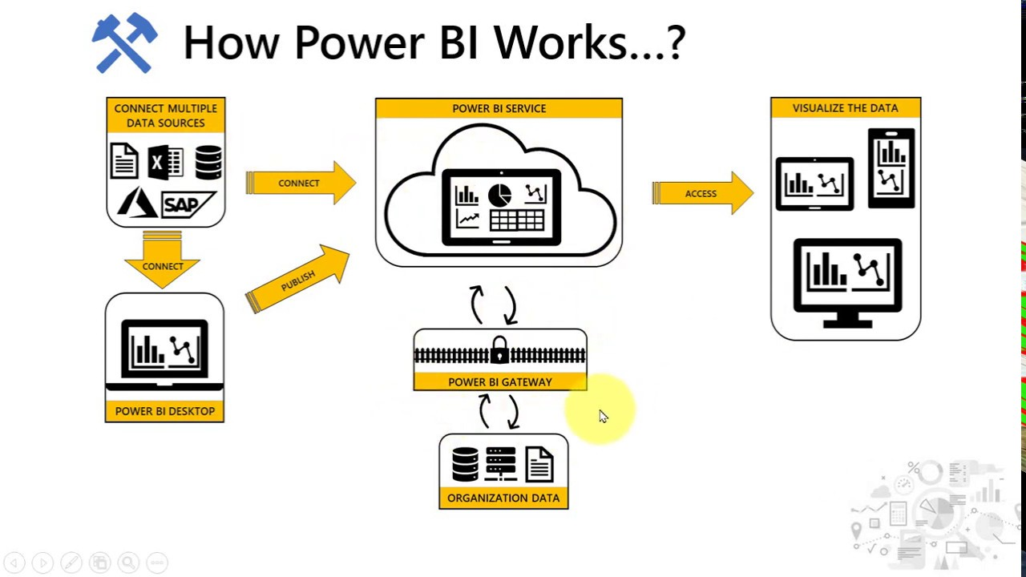
ARCHITECTURE

Slide 9
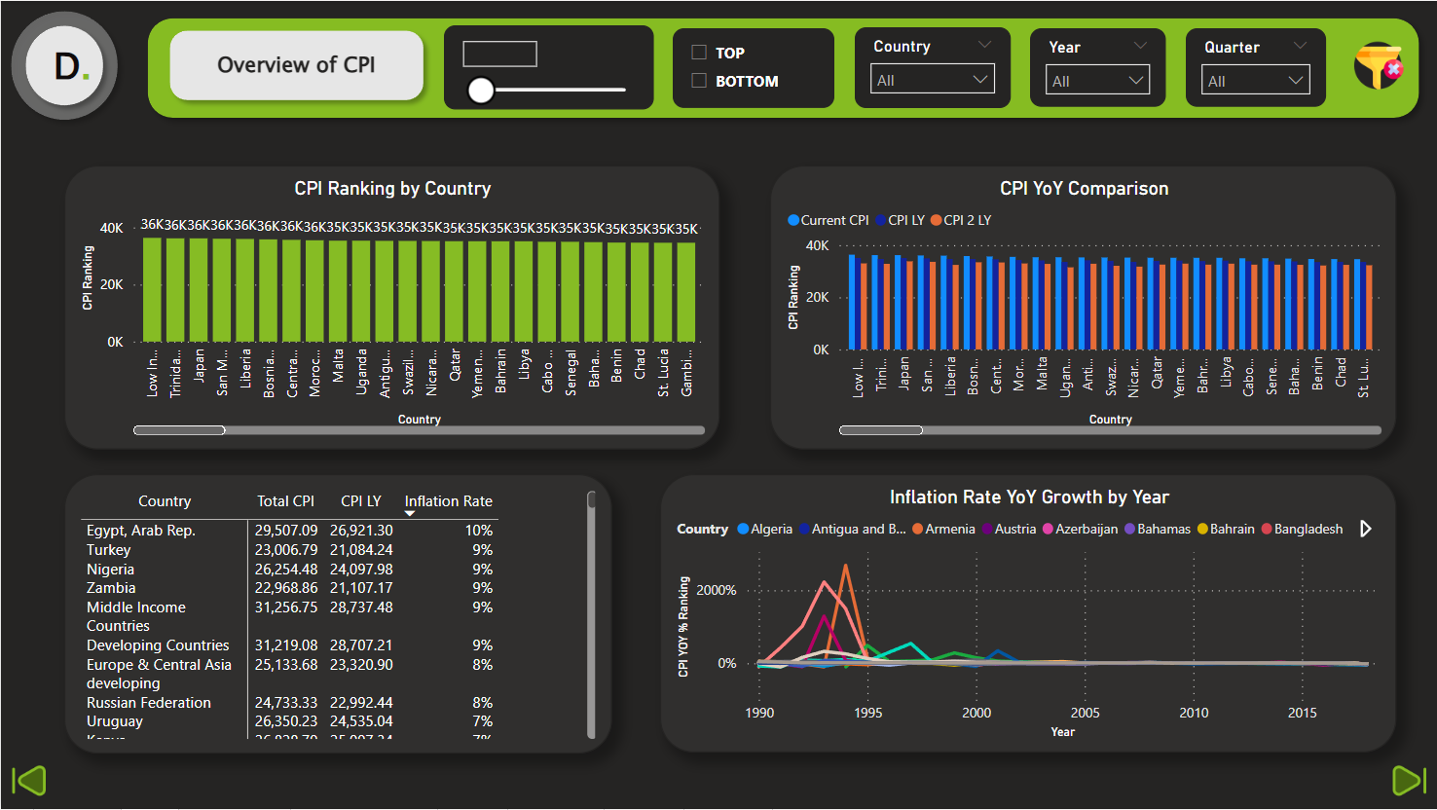
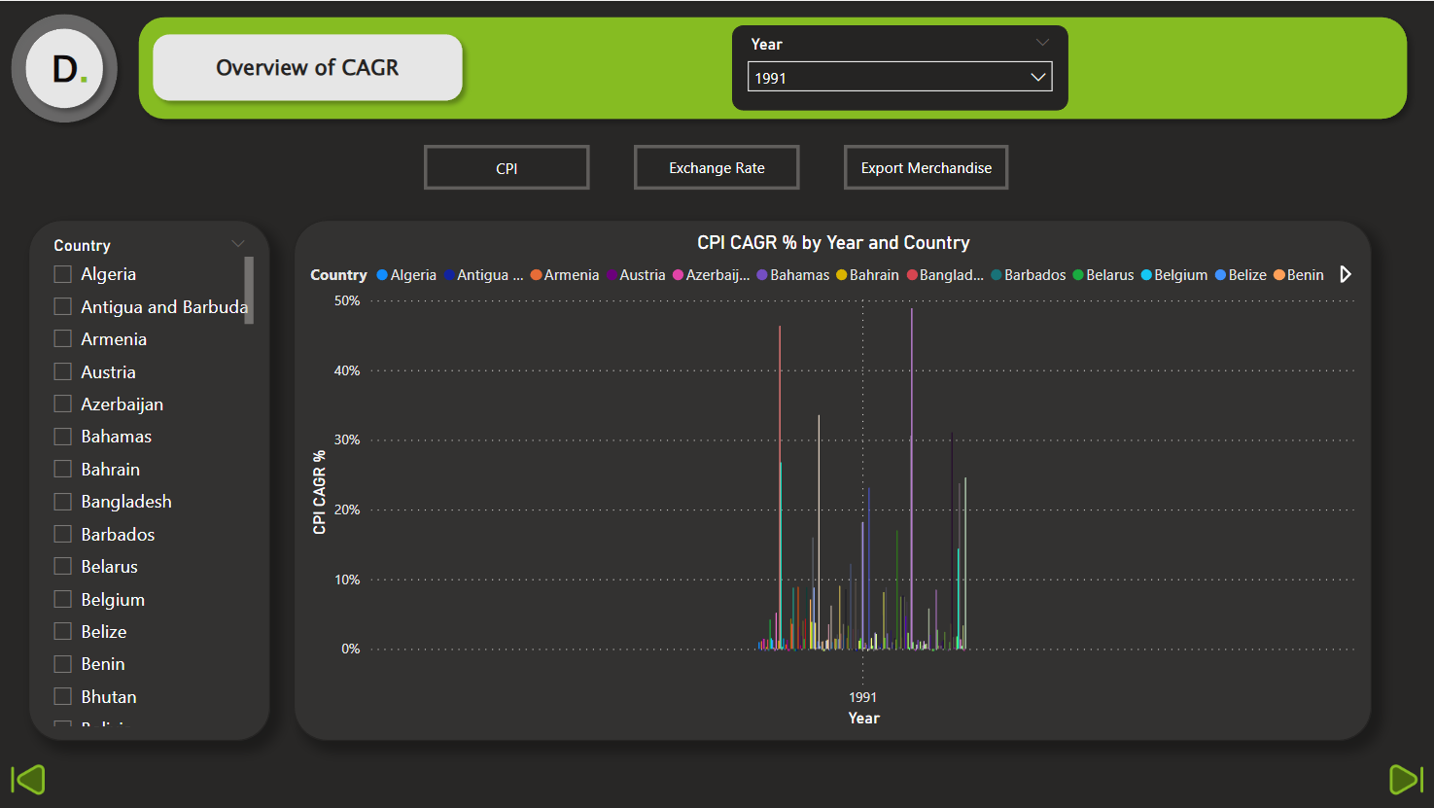
INSIGHTS:

Slide 10
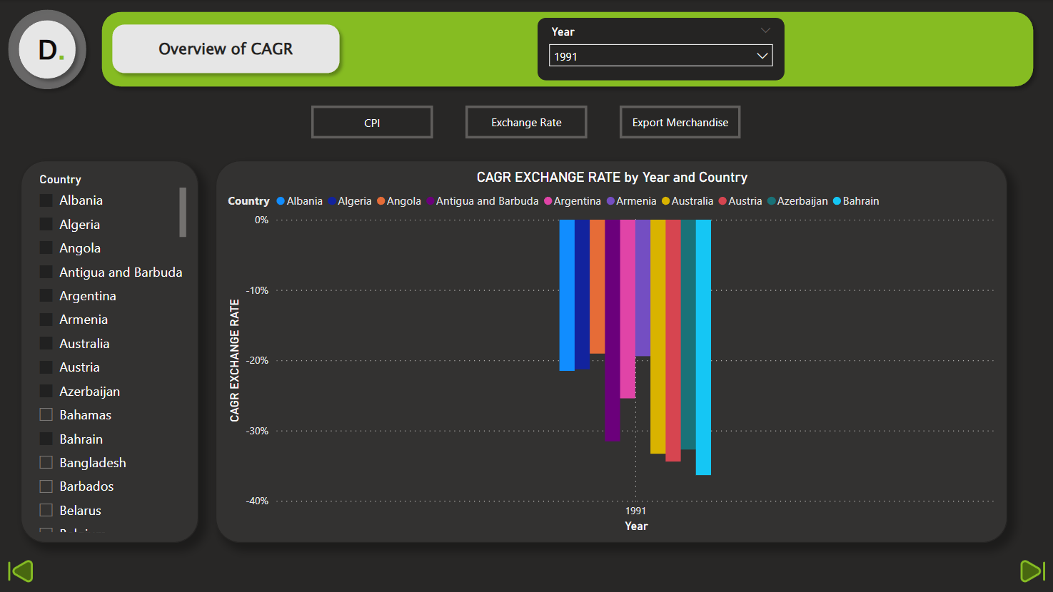
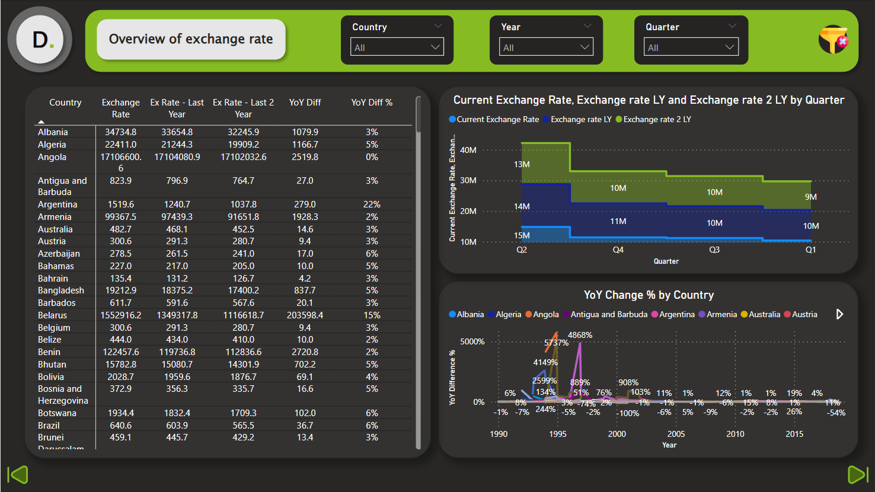

Slide 11
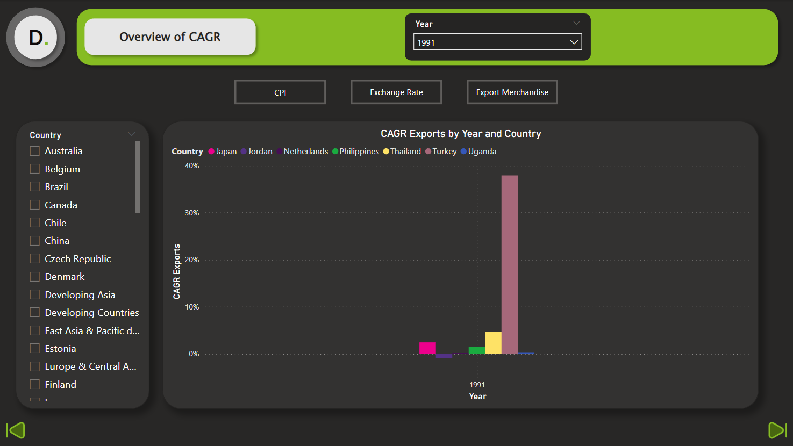
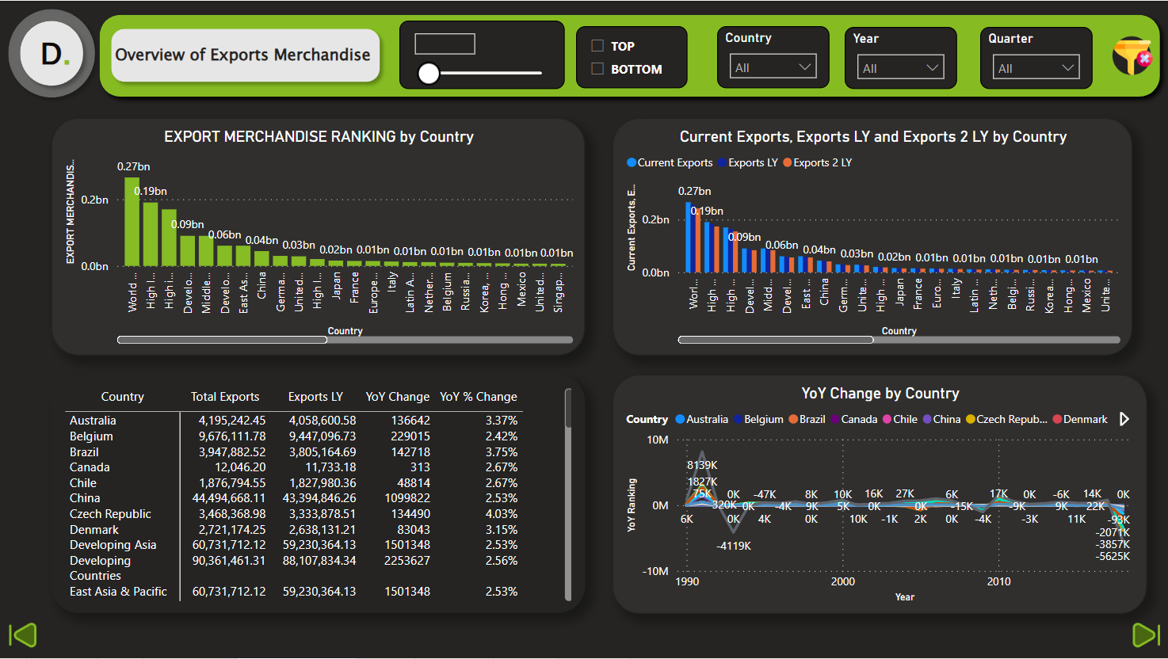

Slide 12
Key indicators displaying a summary of effect on different countries by CPI, EXCHANGE and EXPORTS rate
1. Impact of inflation of different countries
2. Calculation of compound annual growth rate on different countries for different year (1998 to 2018)
3. Calculation of year of year growth rate on different countries for different year
4. Impact of exchange rate on different countries for different year
5. Impact of export rate on different countries for different year
KPI'S:

Slide 13
QUESTIONS:
Q1) What’s the source of data?
The dataset is taken from iNeuron.
Q2) What was the type of data?
The data was the combination of numerical and Categorical values.

Slide 14
Q 3) What techniques were you using for data pre-processing?
Removing unwanted attributes.
Visualizing relation of independent variables with each other and output variables.
Checking and changing Distribution of continuous values.
Removing outliers.
Cleaning data and imputing if null values are present.

Slide 15
Thank you

